Slide 1
Year 10 Microprocessor Control
The IGCSE Systems and Control Design Technology course covers three distinct aspects of technology. These three areas are different but they have one thing in common; they all enable the user to interact with the overall product. By that it means that the user will do something to the product and the product will react or respond in a predetermined way.
The three types of systems & control are;
Mechanical Control Systems
Mechanical control is achieved by building various mechanisms into the product which are intended to produce movement in some way. This movement can be created by the user pushing or pulling part of the product. Electro-mechanical control is achieved by the use of an electrical device (such as an electric motor or solenoid) to drive the mechanisms in order to produce a pre-determined movement.
Electronic Control Systems
Electronic control is where dedicated electronic circuits are used to switch on/off the electric components such as lights, electric motor and solenoids in response to some sort of sensor being triggered or activated. Dedicated electronic circuits are circuits that have been built specifically for one purpose and they can only be used for that one specific purpose
Microprocessor Control Systems
Microprocessor control are very advanced electronic circuits which can be programmed and reprogrammed to many different functions. Microprocessors are often referred to as microchips but their correct name are Integrated Circuits or IC’s for short. Microprocessors are far more versatile than ordinary electronic circuits because they can be reprogrammed quickly and without any need to physically change any components on the circuit. Thereby making these control systems multifunctional. This means that a manufacturer can use the same control system in a range of different products for different applications.

Slide 2
Year 10 Microprocessor Control
System Analysis & Block Analysis
These two terms mean very different things but pupils often confuse they two. It is very important that you understand the difference and can give examples of each.
System Analysis
Refers to the way in which many modern products have been constructed by assembling them from pre-made units. These units are often made by another manufacturer and then shipped to an assembly plant where workers or machines fit the units together to produce the finished product. The advantage of this system of making a product id that the various sub-units or sub-systems can be built and tested independently of the finished product. If an individual sub-system of product fails or malfunctions the unit is replaced quickly and efficiently. It also means that maintenance is simplified and the maintenance technician can be confident that the replacement part will function correctly.
How to do a System Analysis of your project.
The best way to do this analysis is in the form of a spider diagram. Below is an example of how to do it.
Sensors
Lights &
Motors
Control
Program
The
Outer Casing
PIC &
Peripheral
Interface
Your Product
Primary
Gear Box
Mechanism
one
Secondary
Gear Box

Slide 3
Year 10 Microprocessor Control
Block Analysis
Is about identifying the various types of building blocks that are used to create the sub-systems.
There are three generic types of building blocks;
Examples
Digital Sensors
Micro-switch, Push to make Switch
Analogue Sensors
LDR, Thermistors
In your Project
Push to Make Switch
Reed Switch
Photo Transistor
Inputs
Blocks
Any type of Sensor
The parts that respond to information from the sensors and switch outputs on/off
Examples
Electronic Circuits Microprocessors Computer Programs PIC’s
Peripheral Interface
In your Project
Peripheral Interface
PIC
Logicator Program
Process
Blocks
Anything
that can be switched
on or off
Examples
LED’s, Light Bulbs Buzzers, Speakers Electric Motors
Electric Heaters
In your Project
LED’s
Speaker
Motor
Solenoid
Outputs

Slide 4
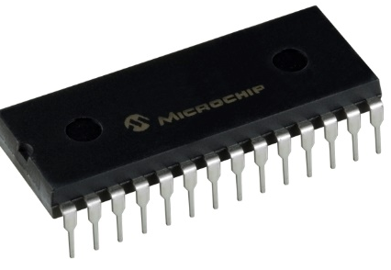
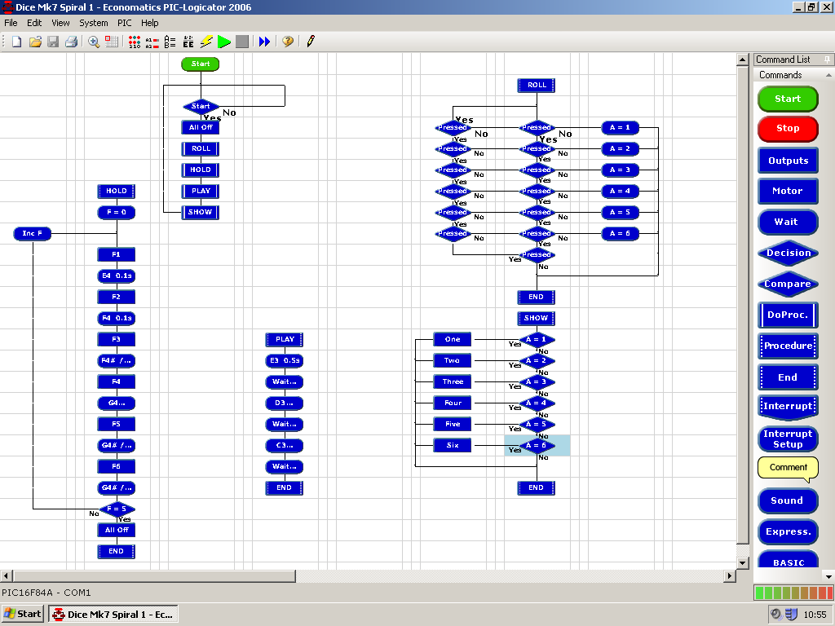
Year 10 Microprocessor Control
The Peripheral Interface
A peripheral interface is basically a portable miniature computer that is inside a machine and which is connected to the INPUT and OUTPUT devices. It is programmed to wait for signals from the from the sensors about environmental changes and then to respond by switch the appropriate OUTPUT devices on or off in a predetermined sequence.
The computer program that controls the Peripheral Interface is downloaded from a main computer onto a special type of microchip called a PIC. PIC stands for Peripheral Interface Controller.
Electrically
Erasable
Programmable
Read
Only
Memory
The PIC is a special type of programmable microchip called an EEPROM.
The computer control program that is stored on the PIC is produced using a software program called LOGICATOR.
This software allows you to write control programs in the form of flowcharts and then it converts the flowchart into a basic form of computer programming language.

Slide 5
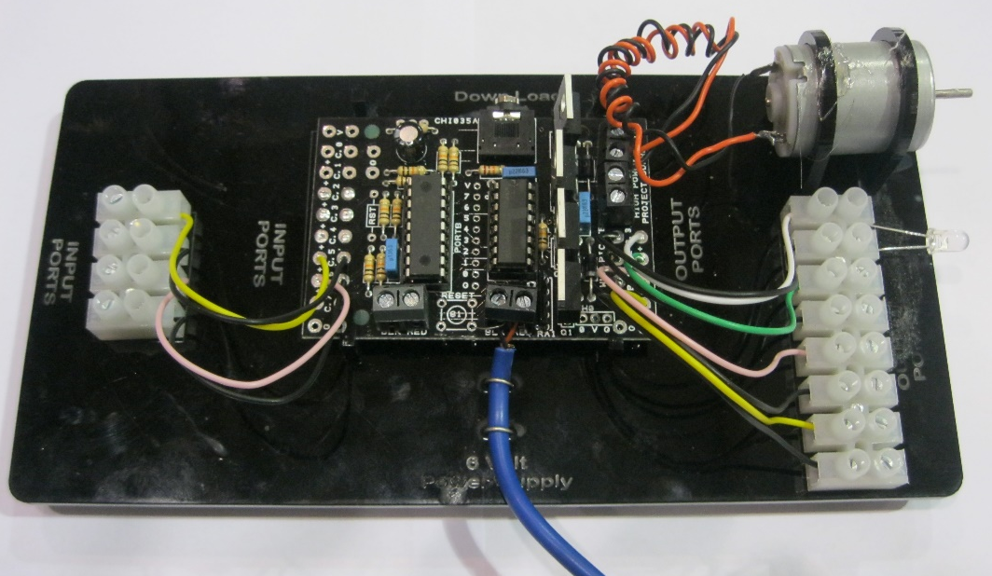
Year 10 Microprocessor Control
How to write a Computer Control Program
The most important thing to remember is that computers will only do what they are programmed to do. If your computer controlled machine is not functioning in the way that you want it to the problem is most likely to be your incorrect sequence of instructions.
There is no such thing as a smart or intelligent computer it is all down to very cleaver programming by the human who is writing the control program.
If you understand how the computer works and how it controls your machine writing the control program is quite simple. It is just a matter of producing a logical sequence of simple instructions and remembering the concepts of INPUT, PROCESS and OUTPUTS.
Your peripheral interface has been designed around this principle
INPUTS
PROCESS
OUTPUTS
Any type of Sensor
Computer Programs PIC’s
Peripheral Interface
Anything that can be switched
on or off

Slide 6
Year 10 Microprocessor Control
Now its time to write a few Computer Control Programs
Remember these basic rules.
Plan out what you want to do before you start writing the program.
Start at the beginning
Keep your instructions simple
Think logically
Remember that the computer needs to be told everything.
If your program is not working as intended it s your instructions that are wrong.
If it works do not try to fix it.

